Slide 1
Bioactivity of Artemisia afra essential oil and extracts and their ability to reduce disease symptoms in wheat caused by the Russian wheat aphid.
Cawood, M.E.¹ & Saba, L.¹
¹ Department of Plant Sciences, University of the Free State, Bloemfontein, South Africa
cawoodme@ufs.ac.za

Slide 2
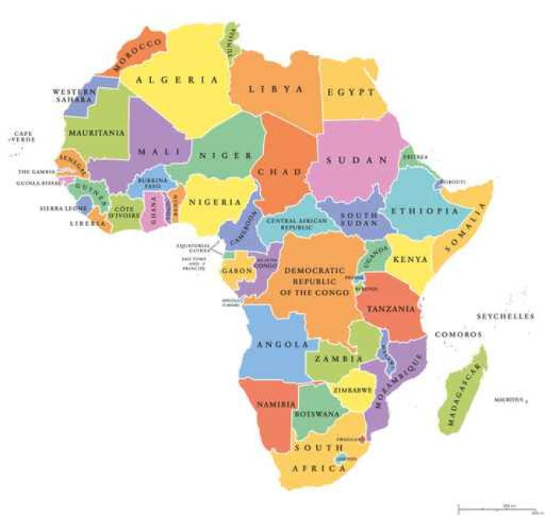
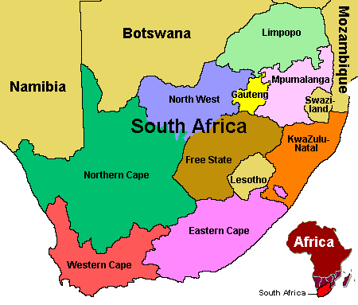
Africa
South Africa
ABC

Slide 3
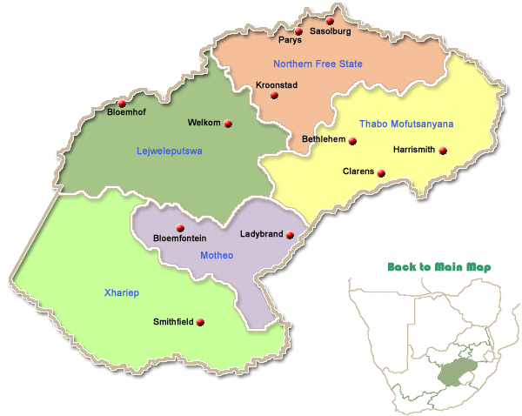
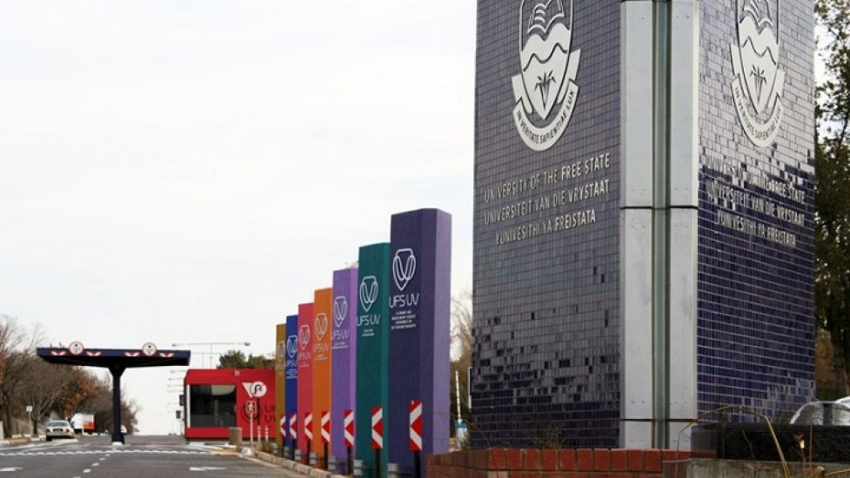
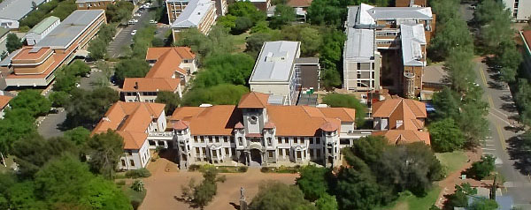
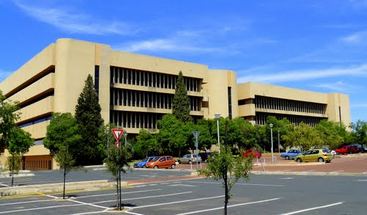
University of the Free State
Free State
Mining
Gold
Diamonds
Coal
Agriculture
Maize
Wheat
Sunflower

Slide 4
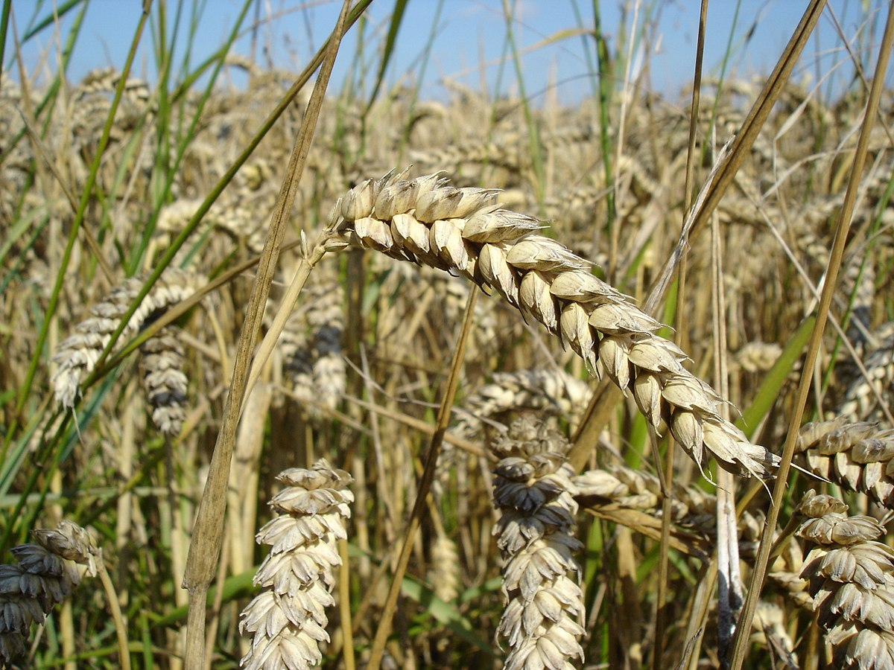
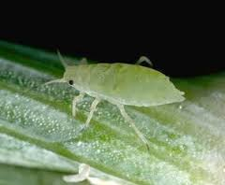
Introduction
Wheat (Triticum aestivum L.)
A major international cereal food crop in the world
Major biotic constraints affecting the production of wheat.
Russian wheat aphid (Diuraphis noxia) is an important international wheat pest also occurring in South Africa
Summer rainfall region of the Free State causing major yield losses
Resistant wheat breeding - most successful management strategy
More virulent aphid biotypes produce new challenges

Slide 5
Russian wheat aphid biotypes
Four RWA biotypes have been recorded in South Africa
RWASA1 – 1978
RWASA2 – 2005, virulent to Dn1,Dn2, Dn3 & Dn9
RWASA3 - 2009, virulent to Dn1,Dn2, Dn3, Dn4 & Dn9
RWASA4 – 2011, virulent to Dn1,Dn2, Dn3, Dn4, Dn5 & Dn9
New RWA resistant genes must be incorporated into cultivars to help keep resistance and delaying chemical control
Time consuming
Therefore, other effective control methods must be explored:
Green Chemistry → Natural products
Notes:
The first RWA resistant cultivar, TugelaDn, was released in
South Africa in 1992 and containing resistance gene Dn1
A new biotype RWASA2, was identified in 2005 virulent to Dn1, Dn2, Dn3 and Dn9
Most of the 27 D. resistant cultivars available for commercial production were overcome.
A third biotype, RWASA3 virulent to Dn1,Dn2, Dn3, Dn4 and Dn9 was reported in South Africa
Recently RWASA4 was now noted and is virulent to Dn5

Slide 6
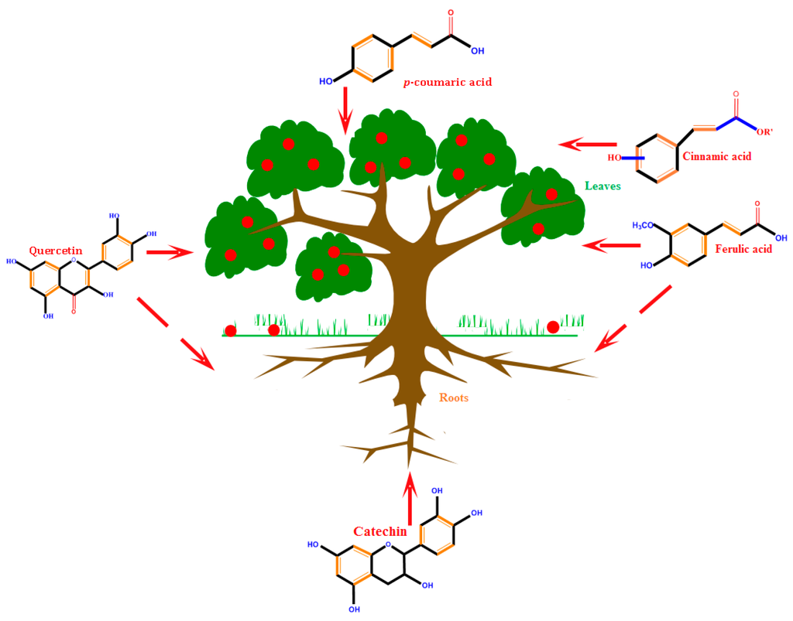
Aim
Explore more environmental friendly ways to protect wheat plants from attacks by the RWA
Do plants contain bioactive compounds acting as:
natural insecticides
repellent products
‘plant activators’ in the resistance response of wheat in general (priming)

Slide 7
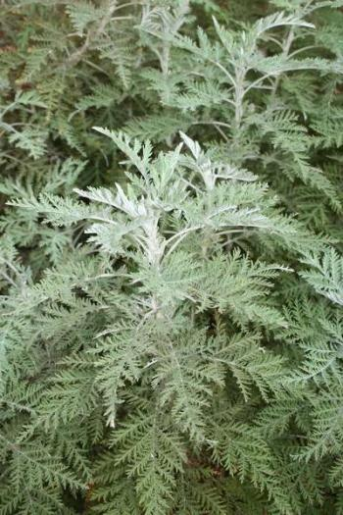
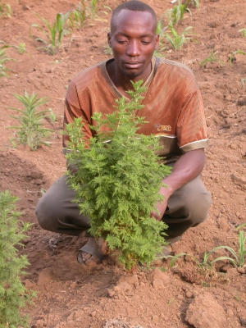
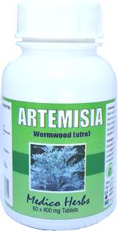
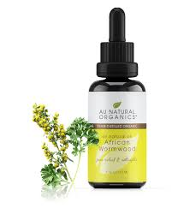
Artemisia afra
Indigenous to South Africa - aromatic bushy shrub.
‘African wormwood’ - belonging to family Asteraceae.
Traditional medicine.

Slide 8
Material and Methods
Plant material
Artemisia afra obtained from Bethlehem, Eastern Free State (28°14’ S, 28°18’ E).
Dried in oven(35°C)
(30 g)
Extraction with H₂O, MeOH and DCM
Filtered.
Concentrated using rotavapor.
Water extract (Freeze dried).
Crude
Extract
Fresh leaf material
(Washed)
Hydro-distilled
Clevenger apparatus
(200 g)
Essential oil
Susceptible and Resistant wheat plants (Tugela and Tugela DN) grown under glasshouse condition.
RWA
Russian wheat aphid South African Biotype 1 (RWASA1)

Slide 9
Material and Methods (identification).
Gas chromatography – mass spectrometry (GC-MS)
GC-MS : Perkin Elmer Clarus 500 Gas chromatogram
Perkin Elmer Clarus 560 S mass spectrometer
Column used was Zebron ZB-5ms capillary GC- column
Step gradient method was used to isolate and identify compounds found in essential oil and dichloromethane (Haouari and Ferchichi, 2009)
One µl of essential oil and dichloromethane extract was injected into GC-MS.

Slide 10
Material and Methods (identification).
Thin layer chromatography
Plates were developed in tank using the following solvent systems:
1.Chloroform-methanol-water-1% formic acid (65:35:5:1) polar extracts
2. Toluene-Ethyl acetate (93:7) non-polar extracts
Compounds present on plates were visualized by UV (254 nm and 365 nm) and detection sprays.
p-anisaldehyde
Detection Sprays
10% vannillin in conc. H₂SO₄
5% Ferric Chloride
Prepared according to Funk et al., 1990
Dragendorf
0.2% DPPH

Slide 11
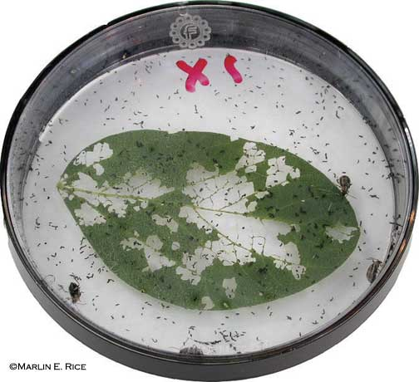
Material and Methods (mortality and fitness).
Direct spraying bioassay (modified method by Singh et al, 2010)
Extracts prepared at varying concentrations.
Twenty aphids placed on petri dish.
Aphids sprayed with extract and left for 1h on open petri dish
Number of aphids alive counted.
Living aphids placed on leaf for 24h in new closed petri-dish.
Number of living aphids counted again (Fitness).

Slide 12
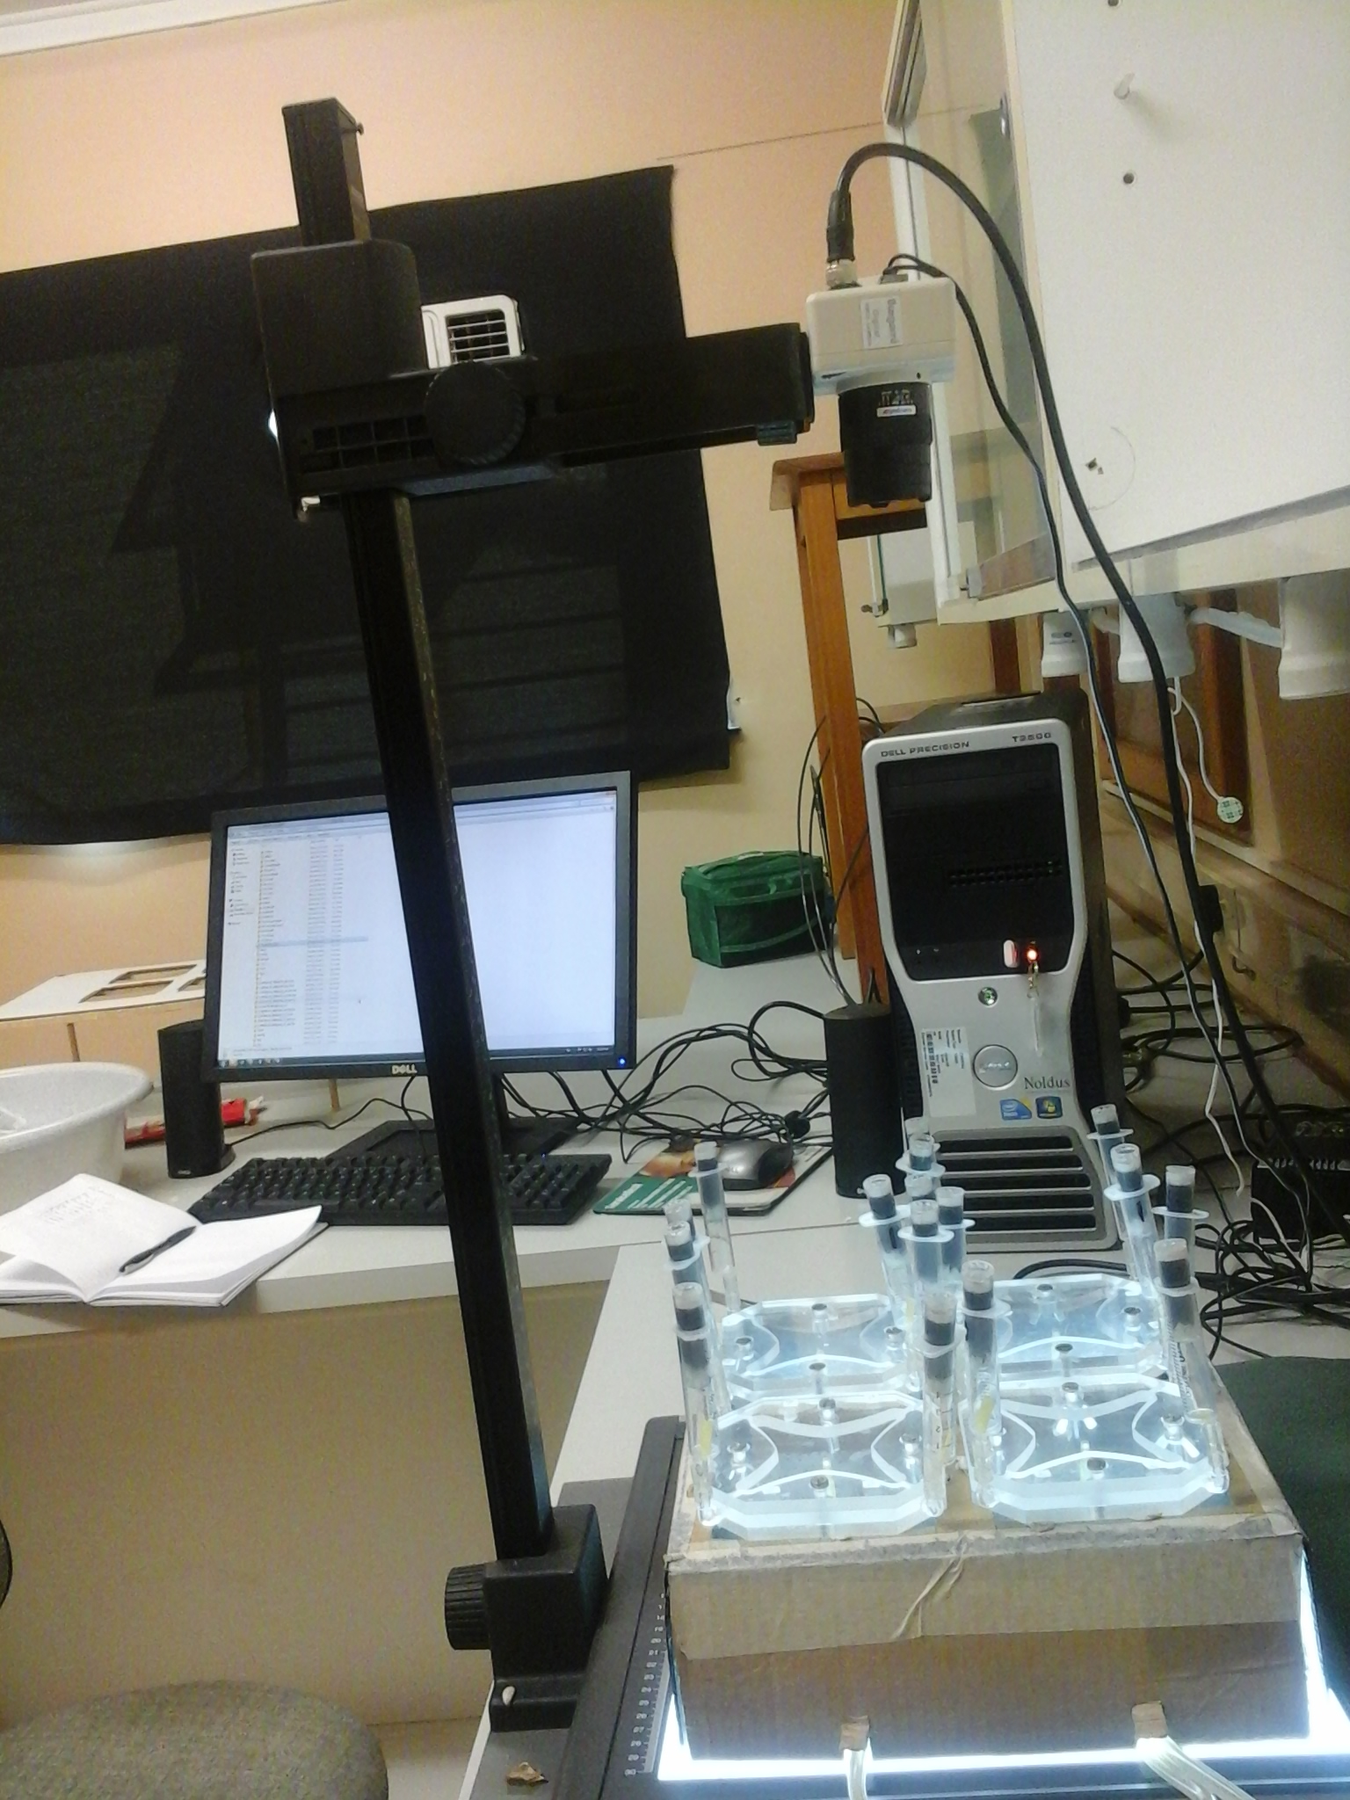
Material and Methods (repellency).
Olfactometry
2 factors considered:
Number of entries.
Time spent.
Digitalised olfactometer using Ethovision XT tracking system software

Slide 13
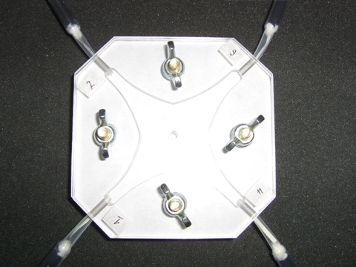
Material and Methods.
Control
Observation area
Extract
Four arm olfactometer was used (Petterson , 1993).
Ten µl of each extract [10 mg/ml] or control solution was deposited on filter paper (odour source).
Odour sources were placed in opposite arms (extract to control).

Slide 14
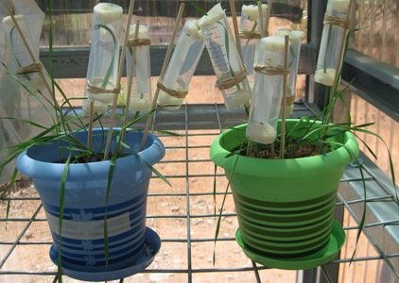
Material and Methods.
Leaf settling bioassay
Resistant [R] and susceptible[S] wheat cultivars used.
Extract concentration = 1 g/L.
Ten aphids put on every 2nd leaf of each plant.
Five replications per each extract spray for [S] and [R].
Number of aphids counted on leaves at 2 h, 6 h 24 h – 72h.
Left until Day 7 for symptom analysis.

Slide 15
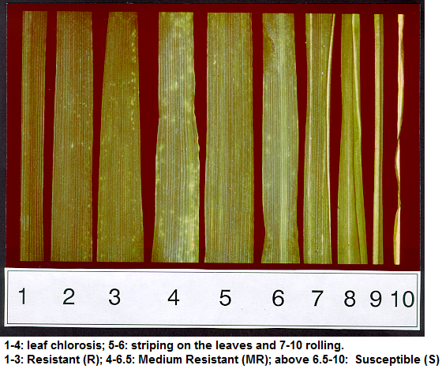
Material and Methods (disease symptom analysis).
Ten point rating scale for damage scores (Tolmay et al., 1999; Jankielsohn, 2014).
Chlorotic spots
Leaf streaking
Leaf rolling
Disease symptoms caused by Russian wheat aphid (OSU wheat files 2013)

Slide 16
Statistical analysis of data
Olfactometer: Generalized linear model with Binomial distribution (p, n) for olfactometer data, one way analysis of variance (ANOVA) with logistic function.
Leaf settling: Average count using trapezoidal rule followed by one way ANOVA (P < 0.05).
Disease rating and symptom analysis: Modified Tolmay et al., 1999; One way ANOVA Pearson chi-square test (P < 0.05).
Induction of defence responses: ANOVA following t-test statistics and P-values associated with comparison.
SAS/STAT version 9.2. NC:SAS [Institute Inc. (2009)] software used.

Slide 17
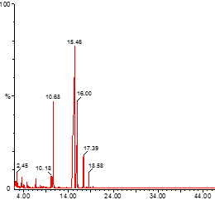
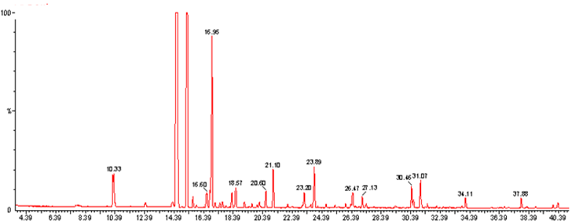
Results and discussion
GC-MS graphs
Essential oil
DCM extract
Figure 1: GC-MS chromatograms of non-polar extracts of A. afra.

Slide 18
Results and discussion
Table 1. GC-MS results of non-polar extracts
Essential oil
Dichloromethane extract
Retention time | Compound name
2.01 | 3-Hexanol
3.45 | α-Terpinene
5.23 | α-Pinene oxide
6.52 | Thuja-2,4(10)-diene
9.34 | Eucalyptol
10.39 | 1,8-Cineole
14.12 | α-Thujone
15.22 | ß-Thujone
16.17 | Artemisia triene
17.01 | Camphor
18.32 | Artemesia triene
21.33 | Hexadecane
25.22 | Octanol
Retention time | Compound name
10.33 | Eucalyptol
14.39 | α –Thujone
15.28 | β –Thujone
16.96 | Camphor
18.57 | Borneol
20.6 | 7-Methyloct-3-en-2-one
21.1 | Piperitol
23.2 | 4-Hexen-1-ol, acetate
23.89 | E-10-Pentadecenol
26.47 | 2-ethenyl-1,3,3-trimethylcyclohexene
Alpha-thujone is a biological active compound - insecticide and an anthelminthic agent for the treatment of parasitic worms
Eucalyptol and camphor- fumigant activity against the red flour beetle (Tribolium castaneum)

Slide 19
Results and discussion
UV-254 UV 365 Dragendorf Ferric Chloride Vannilin
Alkaloids
Phenolics
Terpenes
Arw
Arm
Arm
Arw
Arm
Arw
Arm
Arw
Arm
Arw
Figure 2: A qualitative TLC profile of polar extracts of Artemisia afra. Arm = methanol extract. Arw = water extract.

Slide 20
Results and discussion
Insecticidal
Table 2: Mortality of RWAs 1 h and 24 h post treatment with Artemisia afra extracts.
Treatment | Extract | Mortality
 |  | 1 h post treatment |  | 24 h post treatment
 |  | % | N (out of 400) | % | N (out of 400)
Water (- control) | 1% DMSO | 0 | 0 | 0 | 0
Commercial (+ control) | Raid® | 100* | 400 | 100* | 400
Artemisia afra | Dichloromethane | 53.75 | 215 | 75.25 | 301
 | Methanol | 54 | 216 | 70.75 | 283
 | Essential oil | 50 | 200 | 89.50 | 358
 | Water | 50 | 200 | 74 | 296
N = number of dead aphids. Pearson chi-square test P < 0.05. * = significant.
LC₅₀= 0.396 mg mL⁻¹

Slide 21
Results and discussion
Olfactometry -
Number of visits
Table 3: Probability of RWA visit occurring in treated arms of the olfactometer during 10 min interval.
Plant species | N | Extract | Probability |  | P-value
 |  |  | Estimate | 95% CI
Artemisia afra | 20 | Dichloromethane | 0.3092 | 0.1812 to 0.4753 | 0.0254*
 | 20 | Essential oil | 0.4839 | 0.3296 to 0.6413 | 0.1446
 | 20 | Methanol | 0.4234 | 0.3100 to 0.5454 | 0.2174
 | 20 | Water | 0.5570 | 0.4405 to 0.6676 | 0.3375

Slide 22
Results and discussion
Olfactometry - Time spent
Table 4: Mean time spent in the treatment arms of the olfactometer during 10 minute interval.
Plant species | Extract | Mean (s) | 95% CI | P-value
Artemisia afra | Dichloromethane | -216.58 | -350 to -74.46 | 0.0028*
 | Essential oil | -43.05 | -181.27 to 95.16 | 0.3397
 | Methanol | -0.1620 | -138.38 to 138.05 | 0.9982
 | Water | 115.10 | -23.11 to 253.32 | 0.1021
Volatile compounds -terpenoids and their repellent properties have been investigated against numerous insects

Slide 23
Results and discussion
Leaf settling
Table 5: Mean (±SE) of Diuraphis noxia settled on wheat after exposure to different extracts of Artemisia afra.
Tugela [S]
Plant species | Extract | Time (h)
 |  | 2 | 6 | 24 | 48 | 72
Afra | Essential oil | 3.0±1.58 | 3.0±1.58 | 4.60±1.64 | 5.20±2.30 | 8.4±1.30
 | Dichloromethane | 3.0±1.58 | 5.8±1.20 | 5.8±2.41 | 7.4±4.50 | 13.4±6.58
 | Water | 3.0±.1.58 | 3.4±1.52 | 3.6±1.52 | 3.6±1.52 | 4.00±2.00
 | Methanol | 3.0±1.48 | 3.60±1.20 | 3.20±1.14 | 6.6±2.51 | 8.2±3.9
P = 0.0365
Control | 1 % DMSO | 6.4±2.07 | 6.4±2.07 | 6.6±3.29 | 8.6±3.13 | 10±3.00
Tugela DN [R]
Plant species | Extract | Time (h)
 |  | 2 | 6 | 24 | 48 | 72
A. afra | Essential oil | 3.60±1.34 | 3.8±2.28 | 4.8±2.49 | 6.8±2.49 | 7.6±3.58
 | Dichloromethane | 3.8±3.11 | 4.40±3.41 | 5±3.46 | 6±4.50 | 7.2±1.09
 | Water | 3.68±1.82 | 4.6±2.51 | 5.6±2.07 | 4.8±1.92 | 4.8±2.39
 | Methanol | 3.8±1.48 | 4.20±1.04 | 5.2±3.49 | 6±2.24 | 7.2±3.96
P = 0.6403
Control | 1 % DMSO | 4.6±2.3 | 5.4±1.34 | 6.00±1.22 | 8.6±2.70 | 8.2±3.36
Notes:
Artemisia afra polar extracts showed to be weak repellents in the olfactometer bioassay thus its ability to lower aphid settling may be associated with other factors, probably the actual defence mechanism of wheat plants or other compounds present.

Slide 24
Results and discussion
Phenotypic symptom analysis after 7 days
P < 0.05
Highly resistant
Tugela [S]
Tugela DN [R]
Figure 3: Phenotypic symptom analysis of treated wheat plants.
(Damage score 1 ≤ 2.5 represents a highly resistant plant (no leaf curling), 2.6 ≤ 5.5 represented a medium resistant plant, 5.6 ≤ 10 represented a susceptible plant)
Notes:
Exhibit antibiosis as the number of aphids present after 7 days was lower than the control plants. Plants that exhibit antibiosis affect biological development of an insect and in turn limit the level of infestation

Slide 25
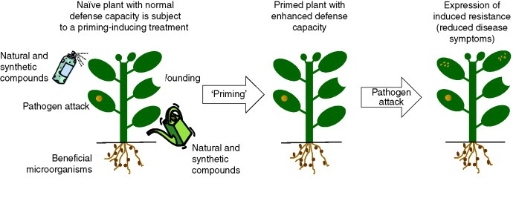
Induced resistance - Priming
Wounding
Pest/pathogen attack
(Conrath et al., 2006).
Priming is an effective tool to sensitise the plant to pest and pathogen attacks.
Notes:
In primed plants, defence responses are not activated directly by the priming agent, but are accelerated following perception of biotic or abiotic stress signals, resulting in an enhanced level of resistance.
Therefore,induce resistance is a host reaction and influenced by the genotype and environment not effecting the pest directly.

Slide 26
Conclusion
Non-polar extracts and oil - same major volatile compounds:
insecticidal
Repellent
Polar extracts – different compounds e.g. terpenes, phenolic compounds and flavonoids
reduced aphid settling on leaves
lowers disease symptoms in wheat plants.
primes plant
Plant extracts contain bioactive compounds that possess the ability to aid in the control of the RWA through various mechanisms and their integration in pest management strategies may prove to be beneficial

Slide 27
Therefore, extracts of A. afra might be another tool to use in addition to genetic plant defence mechanisms and should be a priority to investigate further in field studies

Slide 28
Acknowledgements
Strategic academic cluster no. 4:
Technologies for sustainable crop industries in semi-arid regions

Slide 29
References
Battacharya A, Jaiswal A K, Monobrullah M and JP Singh (2010). Effect of selected pesticides on larval mortality of the neuropteran predator, Chrysopa lacciperda Kimmins of the lack insect Kerria lacca. Journal of Asia-pacific entomology 69:72.
Bradford M M (1976). A rapid and sensitive method for the quantitation of microgram quantities of protein utilizing the principle of protein-dye binding. Anal. Biochem. 72: 248-255.
Conrath U, Beckers GJM, Flors V, Garcia-Agustin P, Jakab G, Mauch F, Newman MA, Pieterse CMJ, Poinssot B, Pozo MJ, Pugin A, Schaffrath U, Ton J, Wendehenne D, Zimmerli L and Mauch-Mani B (2006) Priming: getting ready for battle. Molecular Plant-Microbe Interactions Journal. 19: 1062–1071.
Fink W, Liefland M and Mendgen K (1988) Chitinases and ß-1,3-glucanases in the apoplastic compartment of oat leaves (Avena sativa L.). Journal of Plant Physiology. 88: 270-275.
Haouari M and Ferchichi A (2009) Essential Oil Composition of Artemisia herba-alba
from Southern Tunisia. Molecules. 14:1585-1594.
Zieslin N and Ben-Zaken R (1991). Peroxidase, phenylalanine ammonia-lyase and lignifications in peduncles of rose flowers. Plant Physiol. Biochem. 29: 147-151.
Pettersson, J(1970). An aphid sex attractant. Entomologica Scandinavica, 1: 63–73.
Sommissich IE and Halbrock K(1998). Pathogen defence in plants- a paradigm of biological complexity. Trends Plant sci Rev 3:86-90.
Prinsloo, G.J (2006). Parasitoids and Aphid Resistant Plants: Prospects for Diuraphis noxia (Kurdjumov) control. Ph.D. thesis, University of the Free State, Bloemfontein, South Africa. pp. 34-168.

Slide 30
Thank you
Baie dankie

